Slide 1

Women Artists:
Elements of Art

Slide 2
This slideshow presents four paintings that have interesting LINES, SHAPES, and COLORS.

Slide 3
Each slide has an image (or several) and some questions to encourage discussion about these elements of art.

Slide 4
Look carefully at the images together. Read the questions, share ideas, and make observations.

Slide 5
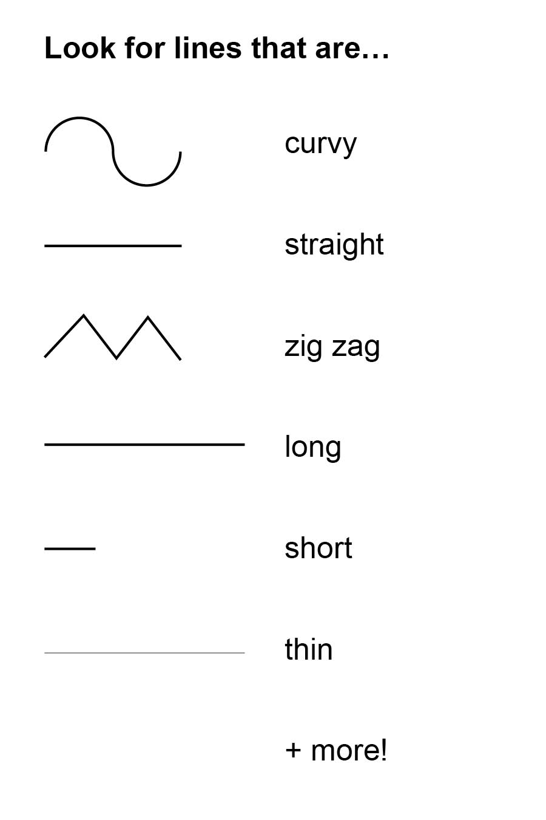
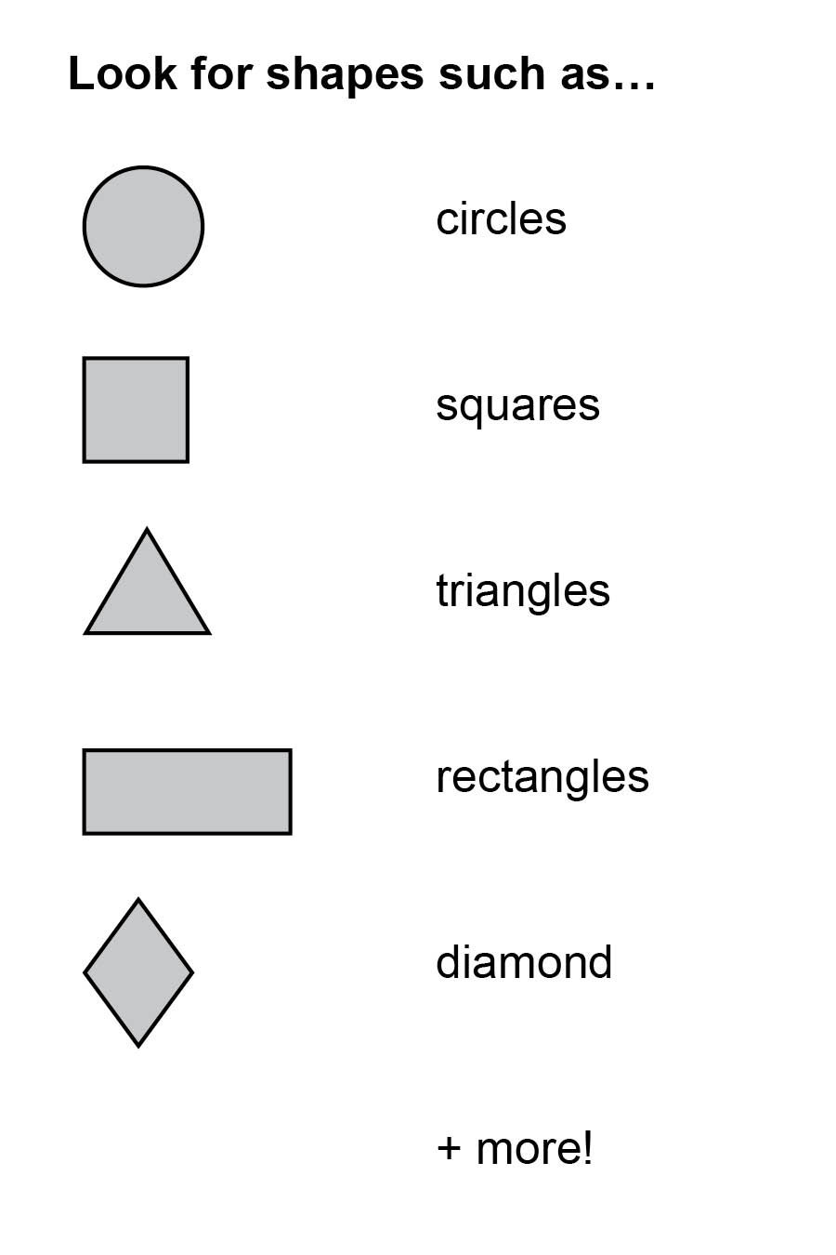
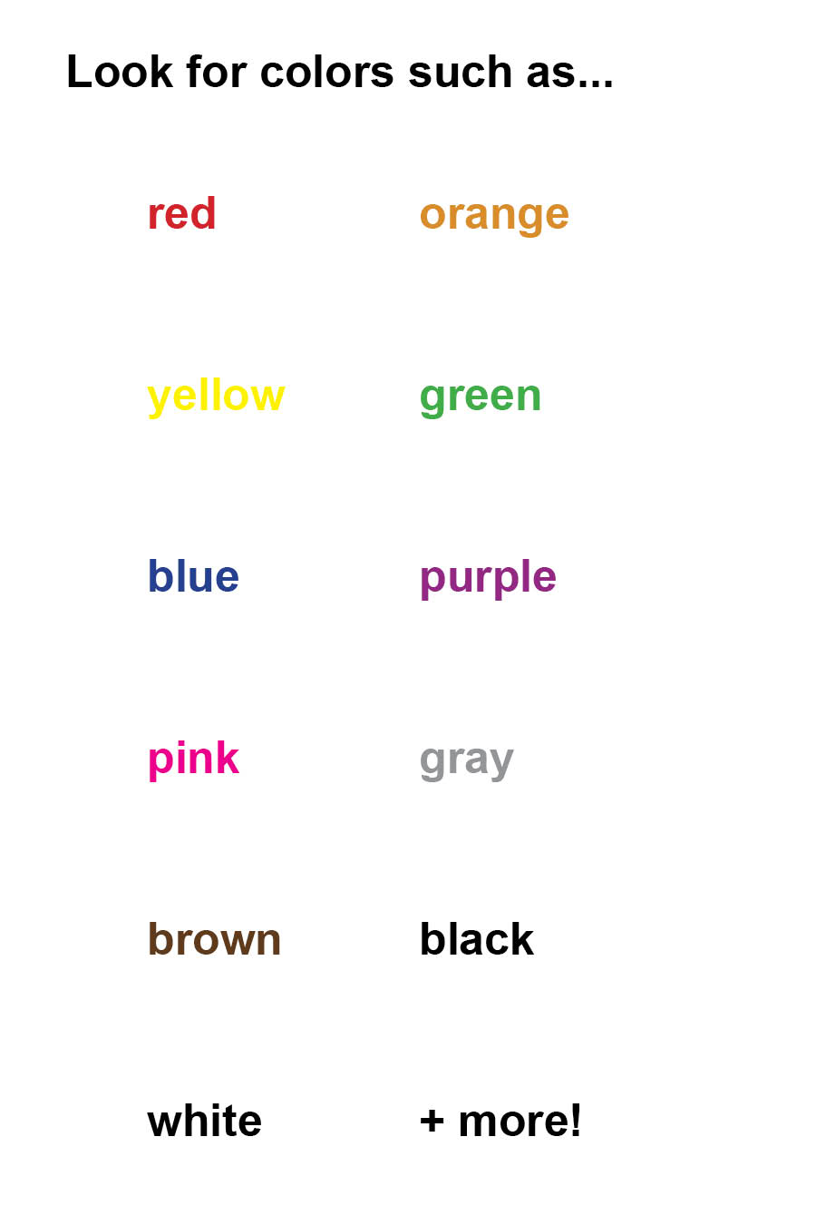
Lines! Shapes! Colors! As you look at the art…

Slide 6
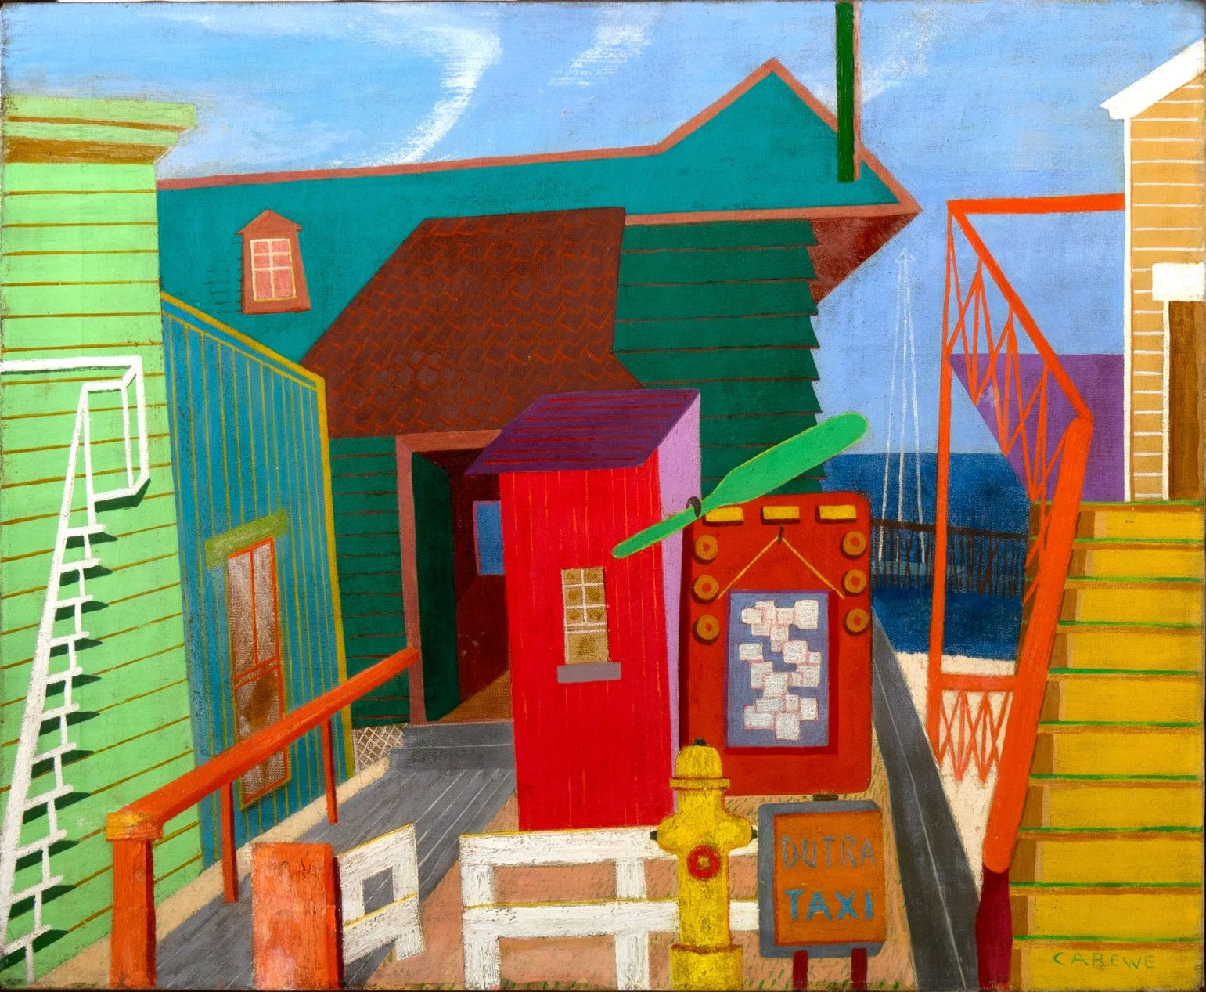
First, take a few moments to look carefully at this painting.
Discuss as a group:
LINES
What kinds of lines do you notice in the picture?
Which ones stand out to you?
Which lines create a pattern?
Sylvia Carewe, Untitled (Dutra Taxi), c. 1945, oil on canvas, 20 × 24 inches

Slide 7

Identify a line that catches your eye. Draw it in the air with your finger.
Share what you noticed about your line.
How are the lines similar and different?
Sylvia Carewe, Untitled (Dutra Taxi), c. 1945, oil on canvas, 20 × 24 inches

Slide 8

SHAPES
What kinds of shapes do you see?
What do the shapes tell you about what kind of place this is?
Sylvia Carewe, Untitled (Dutra Taxi), c. 1945, oil on canvas, 20 × 24 inches

Slide 9

COLORS
What colors grab your attention most?
Which colors stand out next to each other?
Sylvia Carewe, Untitled (Dutra Taxi), c. 1945, oil on canvas, 20 × 24 inches

Slide 10

Sylvia Carewe created this painting of Provincetown, Massachusetts, a seaside town on the Atlantic Ocean.
What details did she include that tell us what it is like?
What other places does it remind you of?
Sylvia Carewe, Untitled (Dutra Taxi), c. 1945, oil on canvas, 20 × 24 inches

Slide 11
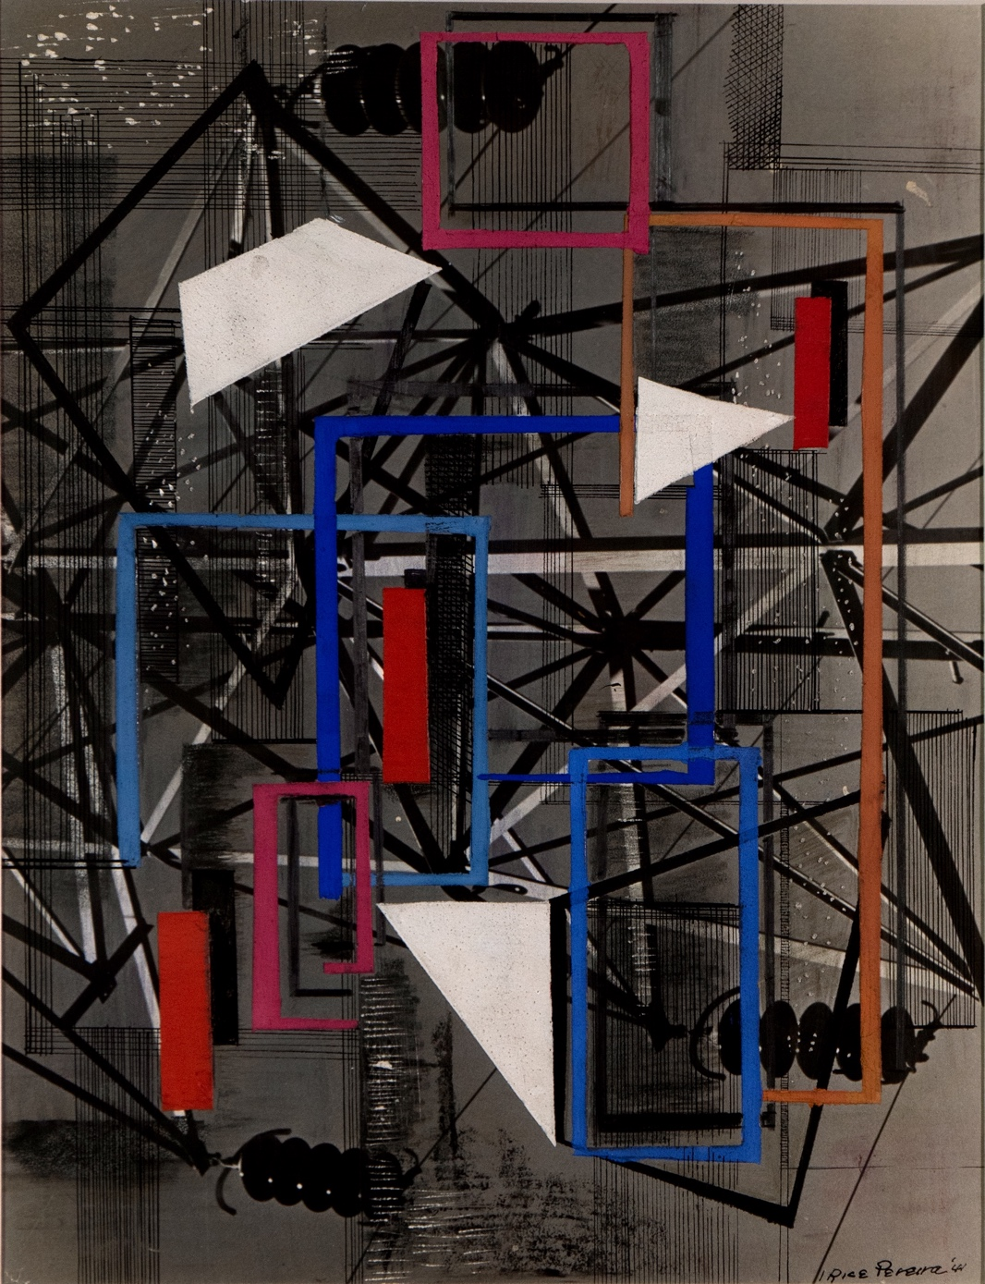
Take a few moments to look carefully at this painting.
Discuss as a group:
How would you describe the lines, shapes and colors?
Which ones do you notice first? Next? Share your observations.
What do you think it would feel like to float into this painting and look around?
Irene Rice Pereira, Untitled, 1941, mixed media on paper, 14 × 11 inches

Slide 12

Irene Rice Pereira was interested in science and art, and was inspired by machines and technology.
What do the lines and shapes remind you of?
Irene Rice Pereira, Untitled, 1941, mixed media on paper, 14 × 11 inches

Slide 13


What is similar about the lines, shapes, and colors in the two paintings? What’s different?
Sylvia Carewe, Untitled (Dutra Taxi), c. 1945, oil on canvas, 20 × 24 inches
Irene Rice Pereira, Untitled, 1941, mixed media on paper, 14 × 11 inches

Slide 14
Take a few moments to look carefully at this collage.
Describe the shapes that you see.
What do they remind you of?
What colors do you notice?
Which ones stand out to you the most?
What types of lines and patterns can you find?
Lorrie Goulet, Holiday Card, 1991, collage on paper, 6 ¹⁵⁄₁₆ × 5 inches

Slide 15
Lorrie Goulet made this collage as a card that she sent to her friend, Renee Gross.
How do you think she felt when they opened up the envelope and saw this artwork?
What is special about sending a card with art on the front?
What do you enjoy about getting a card in the mail?
Lorrie Goulet, Holiday Card, 1991, collage on paper, 6 ¹⁵⁄₁₆ × 5 inches

Slide 16
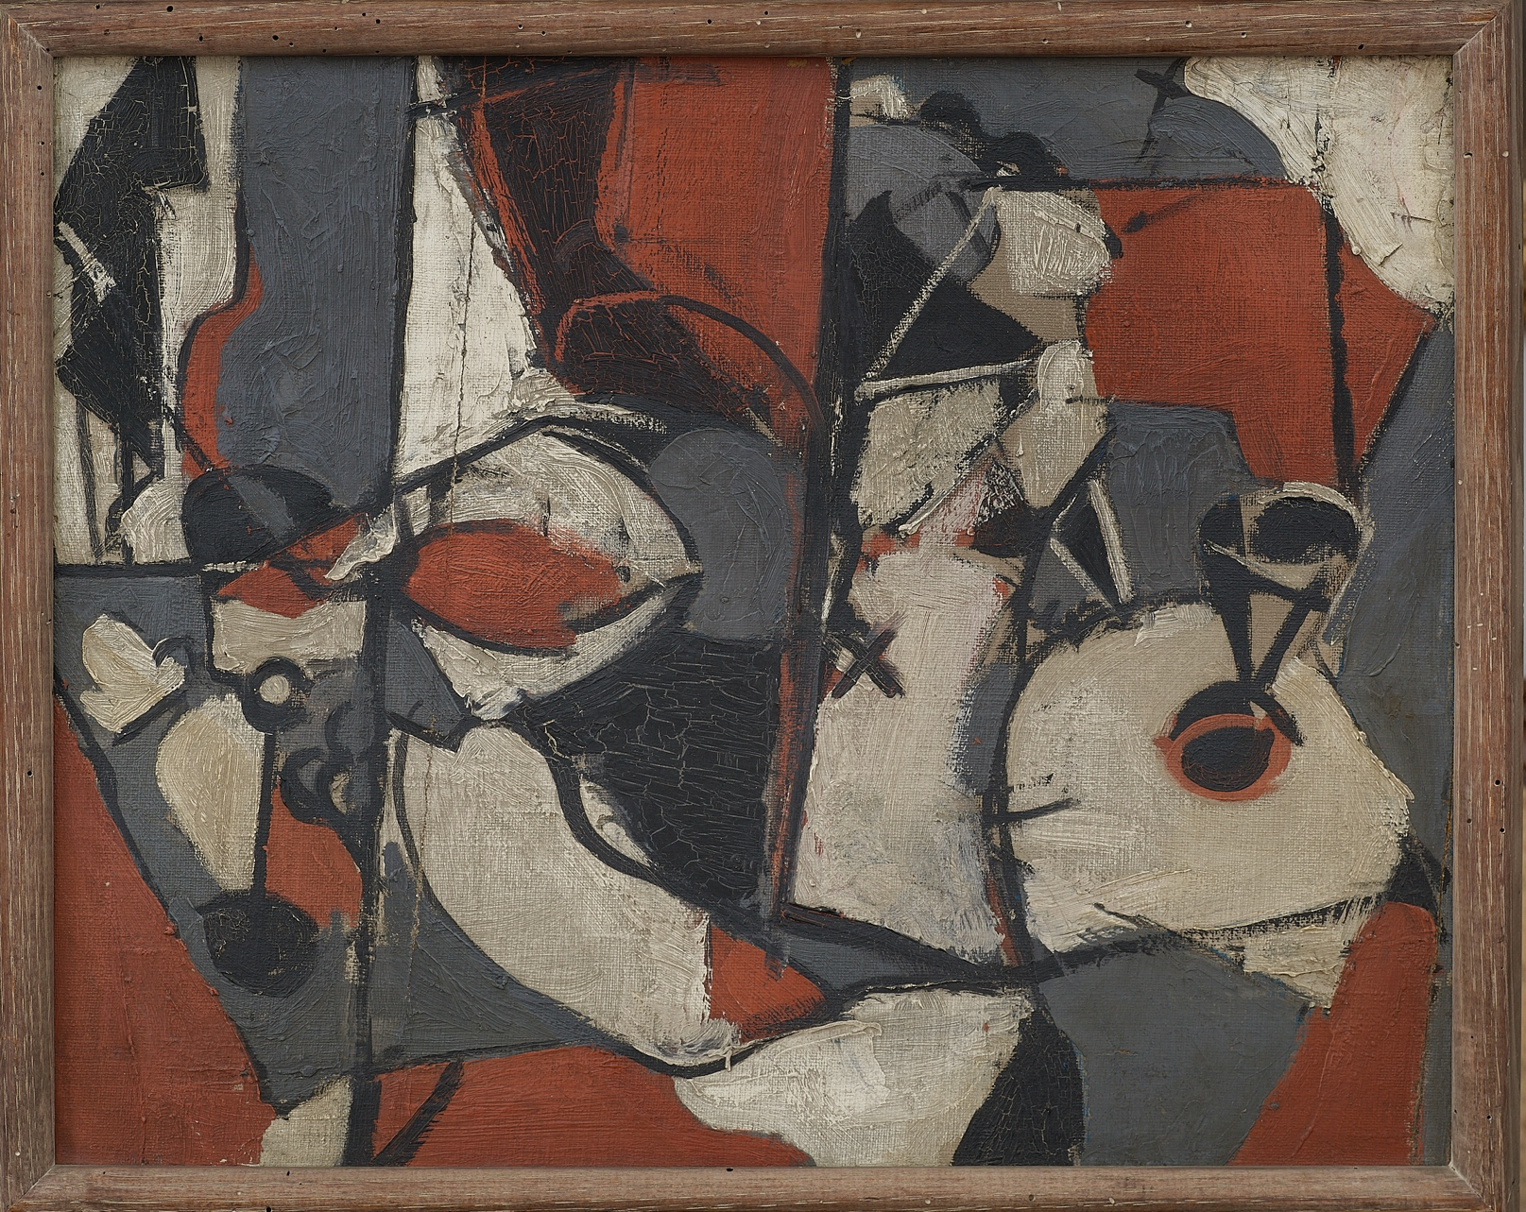
Take a few quiet moments to look carefully at this painting.
As a group, discuss what do you notice about the lines, shapes, and colors.
Mercedes Matter, Untitled, 1934–35, oil on canvas, 16 ½ × 21 ½ inches

Slide 17

This painting is of objects on a table. The artist, Mercedes Matter, showed different views of the objects in the same picture.
What everyday objects do the lines and shapes in Matter’s painting remind you of?
Mercedes Matter, Untitled, 1934–35, oil on canvas, 16 ½ × 21 ½ inches

Slide 18



How would you describe the mood of each one? What do you see that makes you say that?
What is similar and different about the lines, shapes, and colors in these paintings?

Slide 19
Image Credits
Sylvia Carewe, Untitled (Dutra Taxi), c. 1945, oil on canvas, 20 × 24 inches. Renee & Chaim Gross Foundation, New York. © Sylvia Carewe by permission of the executor of the estate of Sylvia Carewe, John Small.
Irene Rice Pereira, Untitled, 1941, mixed media on paper, 14 × 11 inches. © artist's estate.
Mercedes Matter, Untitled, 1934–35, oil on canvas, 16 ½ × 21 ½ inches. Renee & Chaim Gross Foundation, New York. Courtesy of the estate of Mercedes Matter and Mark Borghi.
Lorrie Goulet, Holiday Card, 1991, collage on paper, 6 ¹⁵⁄₁₆ × 5 inches. Renee & Chaim Gross Foundation, New York. © 2024 Lorrie Goulet / Licensed by VAGA at Artists Rights Society (ARS), NY.

Slide 20
First established in 1974 with donations from over two dozen close friends and supporters of American artist Chaim Gross (1902-91), the Renee & Chaim Gross Foundation was incorporated as a 501(c)(3) not-for-profit organization in 1989. The Foundation is located in the couple's historic Greenwich Village townhouse and the artist’s studio space at 526 LaGuardia Place.
The Foundation stewards an extensive collection of over 12,000 objects that includes Gross’s sculptures, drawings, and prints; a photographic archive; and their large personal collection of African, Oceanic, Pre-Columbian, American, and European art that remains installed in the townhouse as it was during their lifetimes.
Our mission is to further the legacy of Chaim Gross through high-quality research, exhibitions, and educational activities around our historic building and art collections for audiences in New York City and beyond.
rcgrossfoundation.org
This project is generously supported by a grant from the Dorothy C. Radgowski Learning Through Women’s Achievement in the Arts Grant, a joint effort of Where Women Made History (WWMH), and Historic Artists’ Homes & Studios (HAHS), both programs of the National Trust for Historic Preservation.

